Slide 1


<Name>
<Date>

Slide 2

Outline
Executive Summary
Introduction
Methodology
Results
Conclusion
Appendix

Slide 3
Executive Summary
Summary of methodologies
Summary of all results

Slide 4
Introduction
Space X rocket launches can salvage the stage 1 rocket boost, thus saving time and money
We want to be able to use a machine learning model to predict if a stage 1 booster will be able to be salvaged after launch

Slide 5

Section 1

Slide 6
Methodology
Executive Summary
Data collection methodology:
Data was collected from the Space X API and included all current rocket launches
Perform data wrangling
Data was cleaned with missing data being filled with mean values and a binary landing outcome variable created
Perform exploratory data analysis (EDA) using visualization and SQL
Perform interactive visual analytics using Folium and Plotly Dash
Perform predictive analysis using classification models
A variety of classification models were used with best hyper parameters being selected and compared based on their accuracy

Slide 7
Data Collection
Data was collected in two ways
Through the SpaceX API
Through webscrapping of Wikipedia
Data accessed through SpaceX API
Data needed cleaning from this source
Data scrapped from Wikipedia
Data needed cleaning from this source

Slide 8
Data Collection – SpaceX API
SpaceX API accessed
Irrelevant variables removed
Important information parsed from remaining variables
Space X API Data Collection Notebook

Slide 9
Data Collection - Scraping
Wikipedia page accessed
Use of Python package BeautifulSoup
Variable column names extracted
Data parsed and extracted
Space X Webscraping code

Slide 10
Data Wrangling
Data Processing
Data Wrangling Code
Check for missing data
Fill missing data values with mean values
Check variable types
Predictor types are good but outcome type is text
Replace outcome variable with numeric binary variable
1 = success
0 = failure

Slide 11
EDA with Data Visualization
Several scatter, bar, and line charts were made looking at successful outcomes and various relationships between variables including:
Flight number with Launch Site, Payload Mass and Orbit Type
Success rate by launch Orbit type
Orbit Type with Payload Mass
Success rate over time (years)
Data Visualization Code

Slide 12
EDA with SQL
Several SQL queries were performed to determine the following:
Unique launch sites
Total payload mass that has been launched
Total payload mass launched by ‘F9 v1.1” boosters
Date of first successful landing outcome on ground pad
Boosters for successful landing outcome on drone ship with payload mass > 6000 and < 4000
Total number of successful and unsuccessful missions
And more!
SQL query code

Slide 13
Build an Interactive Map with Folium
Launch site locations were plotted on a Folium map
The locations were marked with success and failures
Distance from coastlines and railways were also added to the map
These maps were made to visualize if location influences launch success rate
Folium map code

Slide 14
Build a Dashboard with Plotly Dash
An interactive pie chart and scatter plot were created
The features users can interact with are selecting the launch site or all launch sites using a drop-down menu and and selecting a payload mass amount using a slider bar
The pie chart lets users visualize the success rate of each launch site and compare success rates across all launch sites
The scatter chart lets users visualize the success rate of each landing site as well as by booster type and the data can be filtered by a user set maximum payload amount
Dash Interactive Plot Code

Slide 15
Predictive Analysis (Classification)
All models were built and fit in Python using the sklearn package
Models used:
Logistic Regression, Support Vector Machine, Classification Tree, K Nearest Neighbor
Models were trained using a grid search procedure to obtain optimal hyper parameters
Predictive Analysis Code
Train models on training data
Evaluate all models on test data accuracy
Compare models and select best
Grid search with cross validation used here

Slide 16
Results
Exploratory data analysis results
Interactive analytics demo in screenshots
Predictive analysis results

Slide 17

Section 2

Slide 18
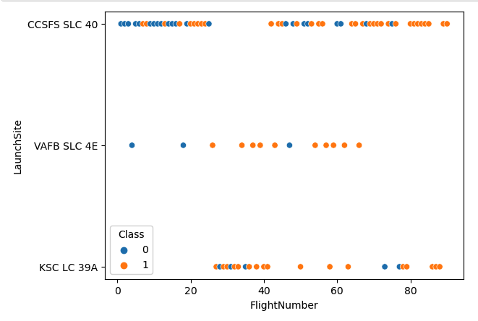
Flight Number vs. Launch Site
Scatter plot shows that there was considerably more failures for early launches (Flight number)
The CCSFS SLC 40 launches site has more failures due to this trend but improved to be about the same as the others after launch 40

Slide 19
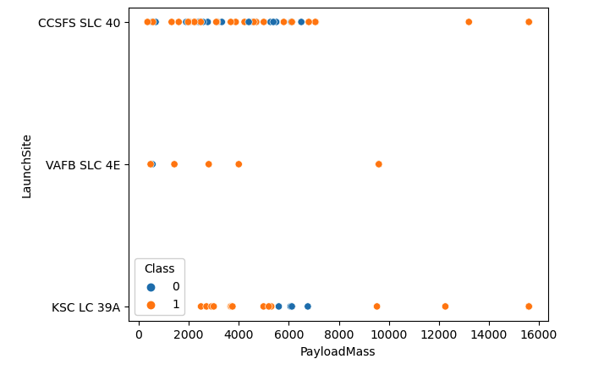
Payload vs. Launch Site
Payloads over 8000 have all been successful although there are few
Payloads around the range of 3000 to 7000 seem to have the most failures

Slide 20
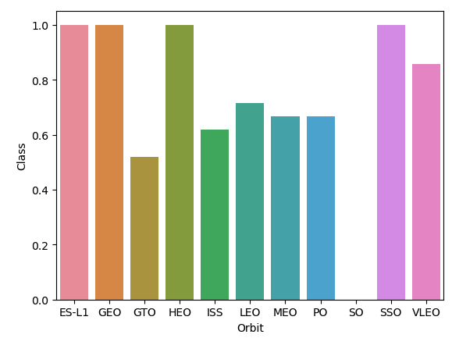
Success Rate vs. Orbit Type
Orbit types ES-L1, GEO, HEO, and SSO have 100% success rate
Orbit type SO has the lowest success rate at 0% followed by GTO at 50%
The average success rate appears to be about 80%

Slide 21
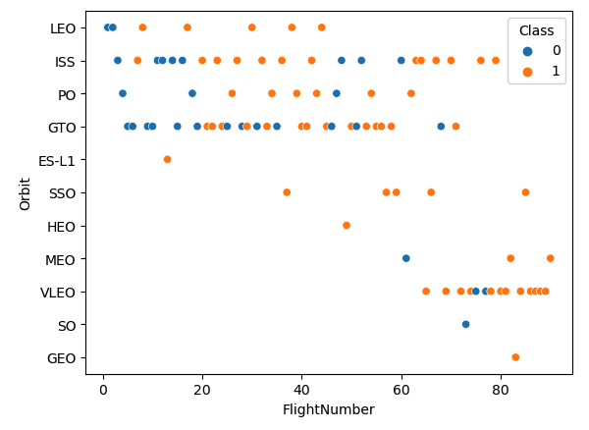
Flight Number vs. Orbit Type
Again we see early launches have more failures
The most common orbit types appear to be ISS, GTO, and VLEO
The orbit types VLEN, SO, and GEO have only been launched fairly recently
The orbit type LEO appears to no longer have any launches

Slide 22
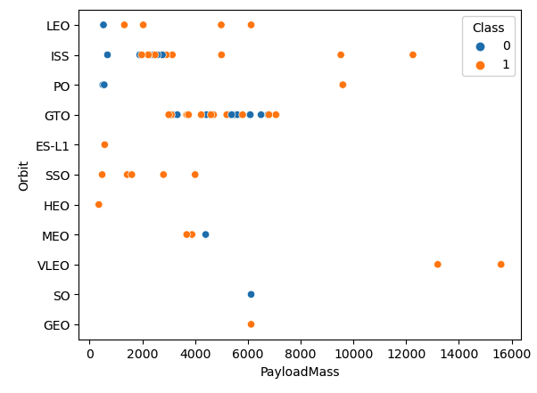
Payload vs. Orbit Type
Again we see that payloads over 8000 are always successful regardless of orbit type
Payloads around the range 3000 to 7000 have the most failures
SSO orbit has a high success rate with various light payload weights

Slide 23
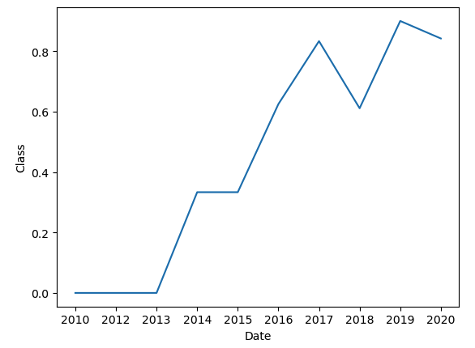
Launch Success Yearly Trend
Here we see that launch success has steadily increased as time as progressed
An indication that SpaceX is learning and improving as time goes by

Slide 24
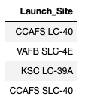
All Launch Site Names
There are four unique launch site locations

Slide 25
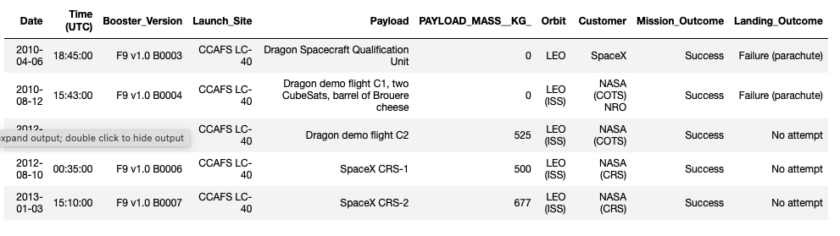
Launch Site Names Begin with 'CCA'
The first 5 records in the data that have a launch site beginning with the letters ‘CCA’

Slide 26
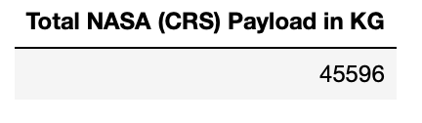
Total Payload Mass
The total combined payload weight in kg carried by NASA

Slide 27
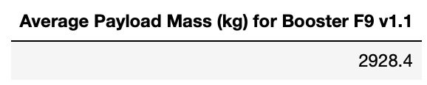
Average Payload Mass by F9 v1.1
Average payload weight in kg for F9 v1.1 boosters

Slide 28
First Successful Ground Landing Date
Date for the first successful ground pad landing

Slide 29
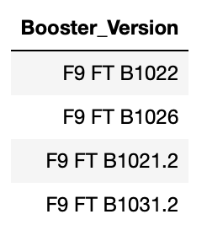
Successful Drone Ship Landing with Payload between 4000 and 6000
List of booster versions that have successfully landed on a drone ship after carrying a payload between 4000kg and 6000kg

Slide 30
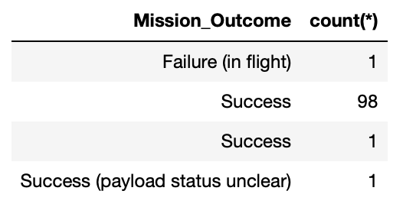
Total Number of Successful and Failure Mission Outcomes
Total number of success and failures

Slide 31
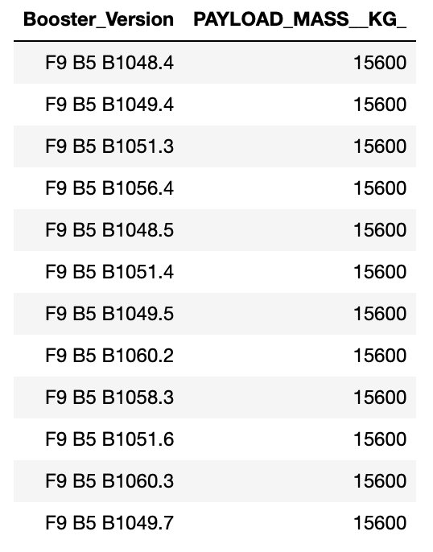
Boosters Carried Maximum Payload
Booster Versions that have carried the maximum payload amount of 15600kg

Slide 32
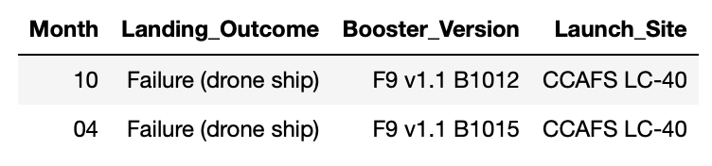
2015 Launch Records
Month, Booster Versions, and Launch Site of failed launch outcomes for the year 2015

Slide 33
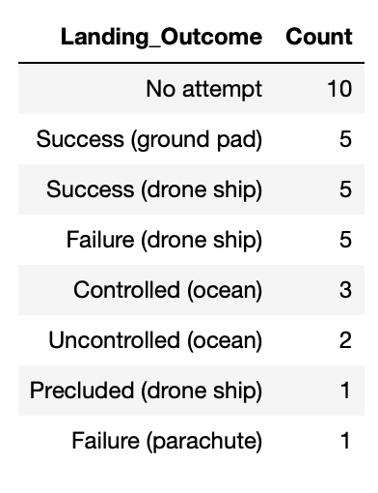
Rank Landing Outcomes Between 2010-06-04 and 2017-03-20
Rank of the count of landing outcomes (such as Failure (drone ship) or Success (ground pad)) between the date 2010-06-04 and 2017-03-20, in descending order

Slide 34

Section 3

Slide 35
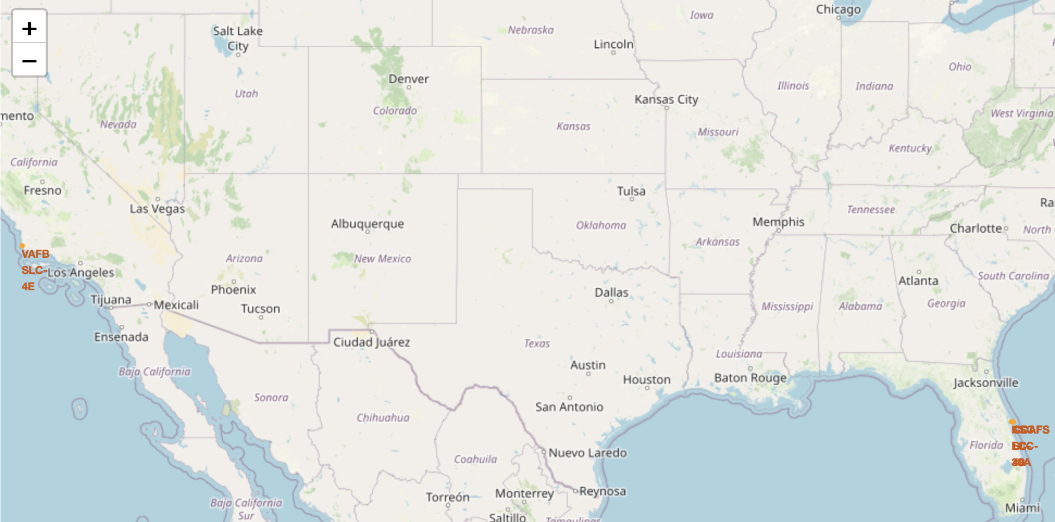
Map showing locations of SpaceX Launches
We can see that SpaceX launches rockets from locations on the Florida east coast and from California
This is because the ocean is an ideal location to attempt to land boosters for reuse

Slide 36
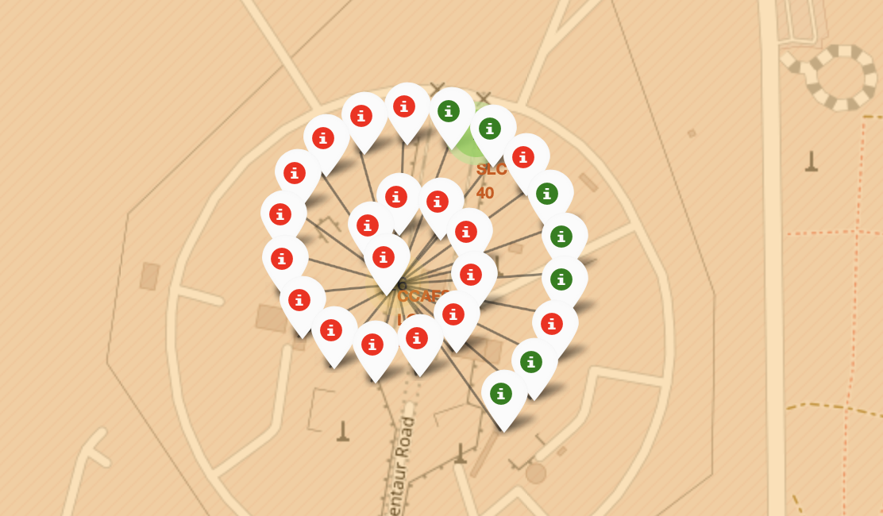
Folium Map of launch results at a Florida location
This map shows launch success as green markers and launch success as red
This is only for one of the Florida launch sites
Similar maps can be seen for the other locations

Slide 37
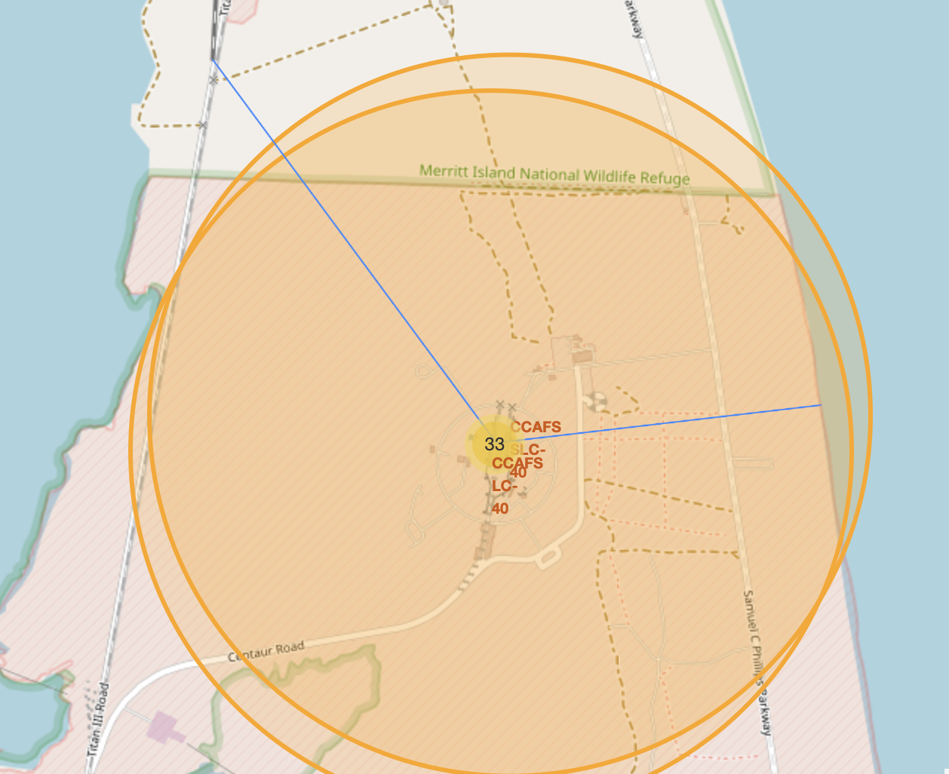
Folium Map of launch site proximity to features
Map showing Florida launch site locations proximity to the coast line and railroad tracks
This location is relatively close to both features

Slide 38

Section 4

Slide 39
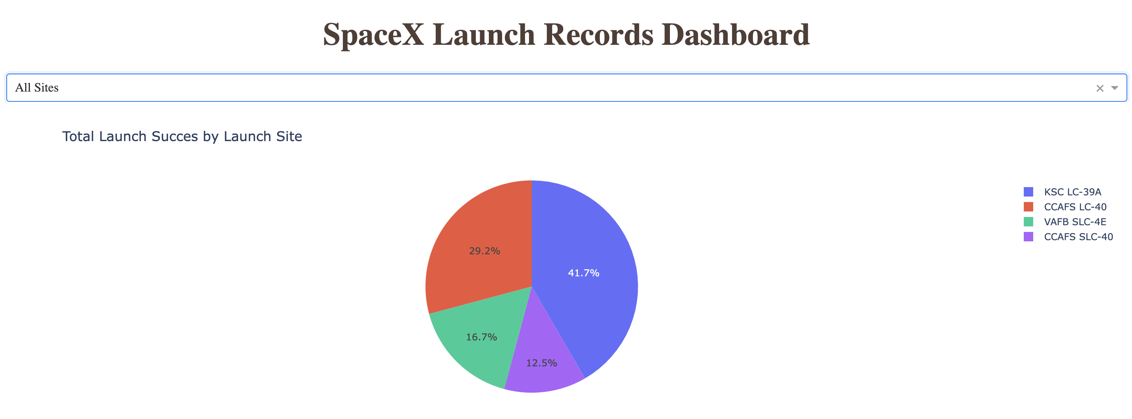
Dash Interactive Pie Chart
Pie chart shows share of success for each launch site.
We see that the launch site KSC LC-39A has the most successes

Slide 40
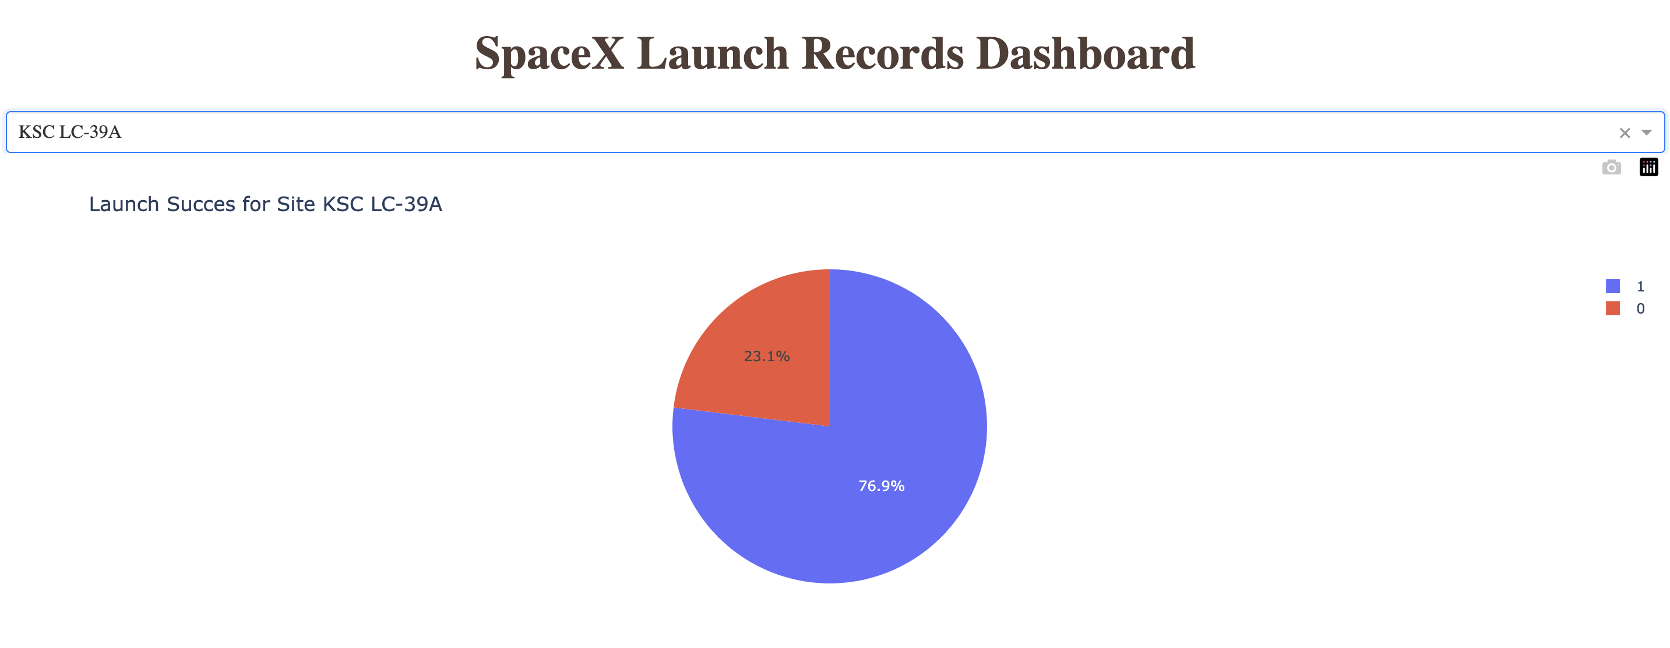
Dash Interactive Pie Chart
Interactive Pie Chart allows user to see the success rate of each individual launch site
We see that launch site KSC LC-39A has the greatest launch success rate

Slide 41
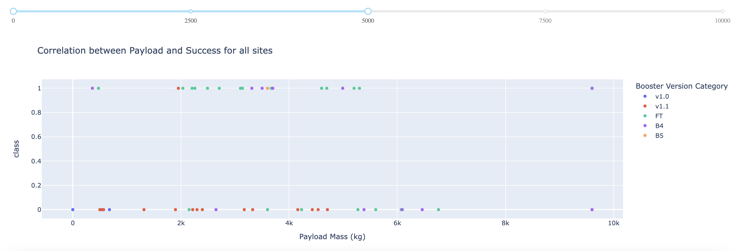
Dash Interactive Scatter Plot
Interactive Scatter plot allows uses to adjust the maximum payload values, then displays success and failures by payload mass color coded by booster version

Slide 42

Section 5

Slide 43
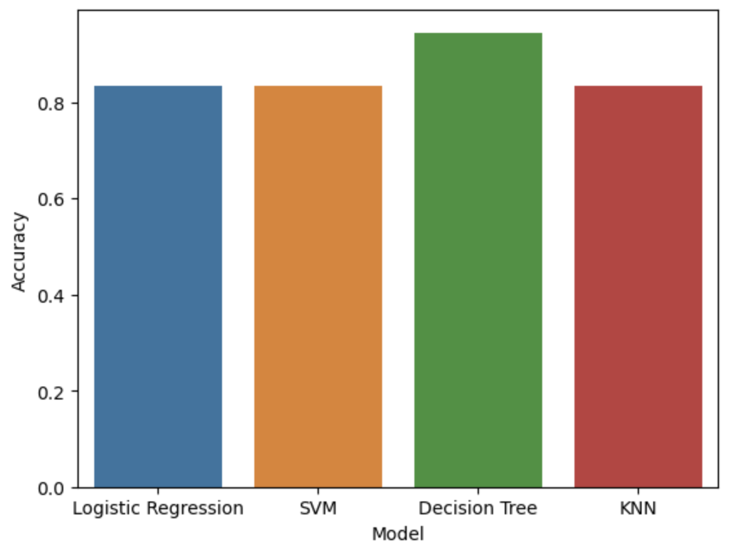
Classification Accuracy
All models performed fairly well in terms of classification accuracy of the test data
The Decision Tree model performed the best with an accuracy of 0.94

Slide 44
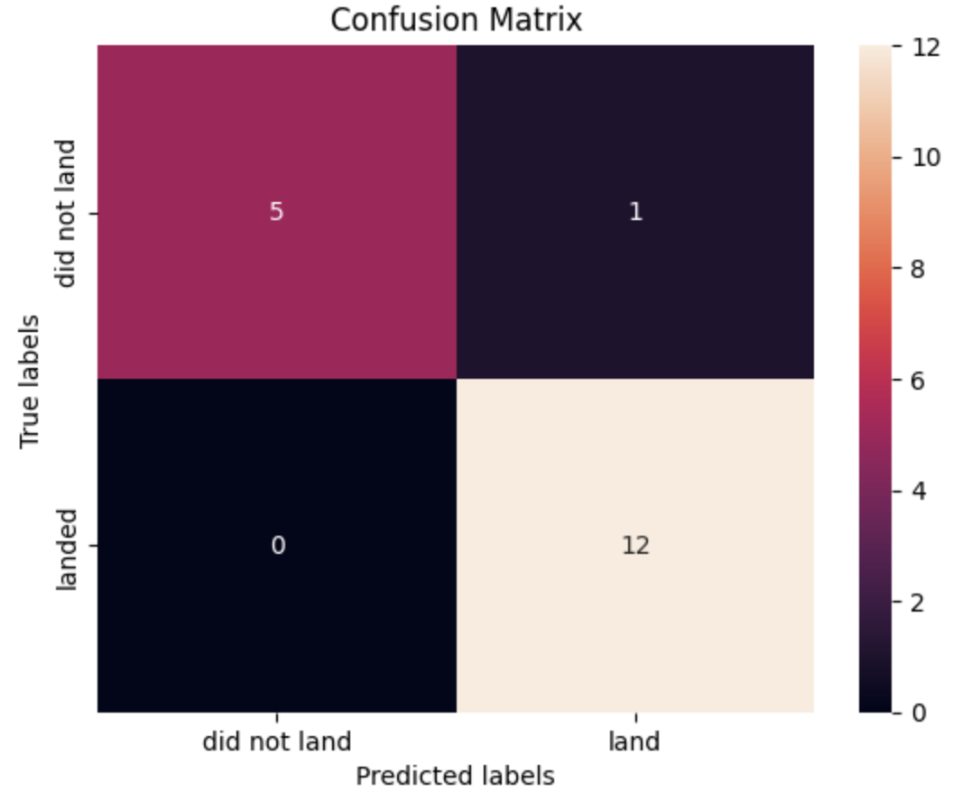
Confusion Matrix for Tree Model
The confusion matrix for the tree model shows only one misclassification
It does well in predicting both true positives and true negatives while minimizing false positives to 1 and false negatives to 0

Slide 45
Conclusions
API and Webscrapping worked well to collect data but both required additional cleaning
Visualization revealed time was a major predictor of success, which indicates SpaceX is improving their procedures over time
Dash interactive Dashboard gives great insights into specific launch site success rates
Predictive modelling revealed that a Classification Tree model with optimized parameters can perform very well for predicting launch failures and success

Slide 46


